Slide 1
Gryphin Update
May 9, 2018
Gryphin Team

Slide 2
Agenda
Gryphin State of the Union
Plans and releases
Our Architecture evolution
Release 1.0
Prep/Dep – IT engagement -
Integration with other apps
Support for projects
High Availability discussion
Production topology
Issues, risks, mediation
Staffing
Offshore

Slide 3
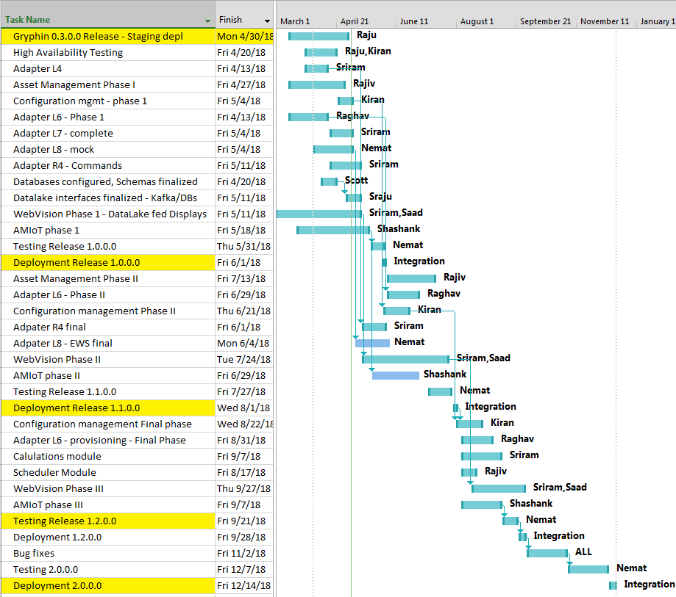
Our 2018 Plans

Slide 4
Gryphin Internals evolution..

Slide 5
Gryphin Internals evolution

Slide 6
Release 1.0.0.0 – 6/1 - Scope
Support for Complete flow of telemetry and commands for, GP, LoRa
All adapters – L4, L6, L7, R4
Data models, schemas, etc. in-motion and at-rest
Integration with GridControl– Phase I
Asset Management - Phase I
Configuration Management – Phase I
Support for External Interfaces
USEF, Weather, Tariff, etc.
Integration with DERMS Comm module
UI Phase I – WebVision support for Gryphin Data Lake
Push/Pull infrastructure support

Slide 7
Release 1.0.0.0 – Prep/Depend
Hardware
Ordering, setup, etc.
IT – next slide
Integration Team engagement
High Availability setup
Resiliency, within and across sites
Fully adopting Websupport usage
Putting in place a set of DevOps best practices and tools:
Auto Build, Unit Testing
Build and deploy scripts (Ansible scripts)
Tools for Monitoring and metrics (initial set)
Code coverage and enforcement

Slide 8
IT Coordination
Conforming to the rules of the land
Architectural, Technology, Topology discussions
New stack (on-going)
Education
Staffing,
Biz process
Compliance requirements
Achieving it with new technologies
Websupport / Compliance
GIT (our new source management system) move out of the DEV boxes

Slide 9
Continuous Integration & Deployment
Continuous Integration (CI) is a development practice that requires developers to integrate code into a shared repository several times a day. Each check-in is then verified by an automated build, allowing teams to detect problems early.
By integrating regularly, you can detect errors quickly, and locate them more easily.
Changes are automatically deployed to staging servers frequently, fully auto-tested, and without manual intervention.

Slide 10
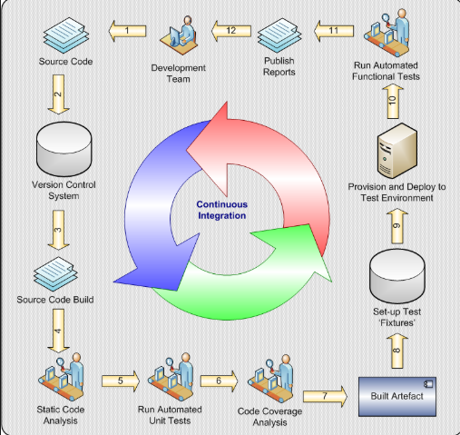
Continuous Integration & Deployment

Slide 11
Code Coverage
Code coverage is a measure used to describe the degree to which the source code of a program is executed when a particular test suite runs.
A program with high test coverage, measured as a percentage, has had more of its source code executed during testing, which suggests it has a lower chance of containing undetected software bugs compared to a program with low test coverage.

Slide 12
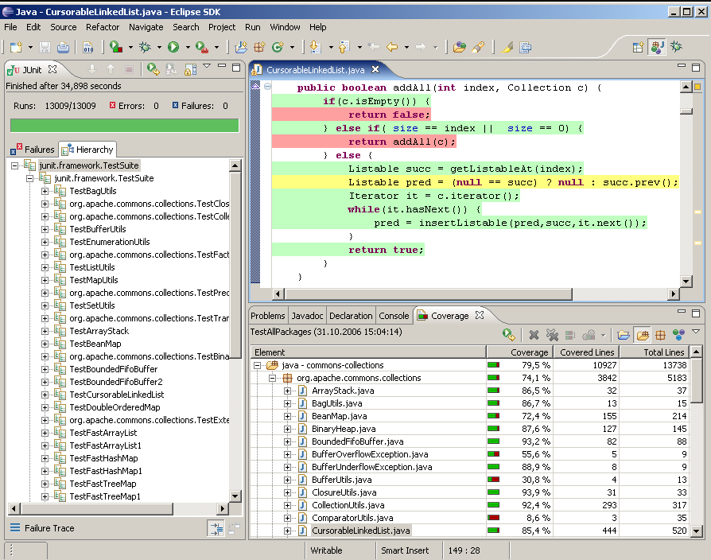
Code Coverage

Slide 13
Monitoring & Metrics
Collect Metrics and monitor major Gryphin components (configured for an initial set):
RabbitMQ
Kafka
Zookeeper
Mongo
Postgres
Influx
Gryphin Application metrics
Web servers
Linux Servers
This will be a continuous evolution, addition, and refinements

Slide 14
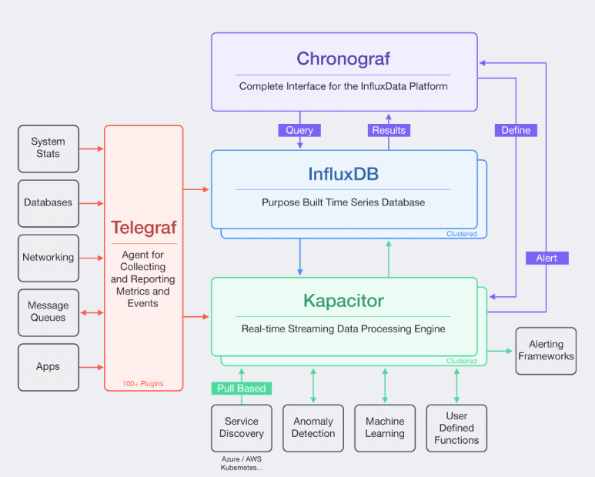
Monitoring

Slide 15
Release 1.1.0.0 Scope – 8/1
Asset Management Phase II
UI screens for upload, editing
Configuration Management Phase II
EU coefficient, Alarm limits, Point containers, etc.
UI screens for upload, editing
L6 – phase II – support for provisioning., security
L8 – Phase II – Full backend integration for support for External Web/REST services
UI Phase II – Webvision
Support for graphical widgets
WebGEO

Slide 16
Integrating with apps
GridControl
Telemetry/Control GP2 via MQTT
Asset Management
GridPort - Support for all GP1 and GP2 messages
AMIoT
LoRa Server support
Asset Management
DERMS
EWS Data Exchange
Processing commands via the bus
SCADA
Alarm/Point processing, EU conversion
Gridmind
Exchange Telemetry, Alerts and Events.
historian for reporting, Timeseries and event analysis

Slide 17
Support of Projects
IOS
Telemetry (all HPCS data)
Events (HPCS events)
Controls (DER controls and DER curves)
External Web/REST interfaces for
USEF messages, Tariff, BTM Readings
EIDSN
ACE calculation
Inertia calculations
WebGEO and WebVision Integration
Demonstrations
DTECHs,
Energy Conferences

Slide 18
High Availability- Topology

Slide 19
High Availability - Status
Extensive testing was performed to test resiliency of our multi-site configuration
Positives:
Kafka, Zookeeper and Mongo work very well in a clustered, multi-site setup and can handle site outages and network partitioning (split brain) very well.
RabbitMQ’s clustering works very well within one site but cannot be deployed as single cluster cross site
To be completed:
InfluxDB clustering and high availability (limited functionality is provided by Relay as a stopgap) a few options are available
Postgres clustering is under evaluation – a few options are available
OATI application access/failover/HA to Gryphin
Risks:
Zookeeper and Mongo depend on US-Internet to serve as a third site to aid in elections. Any latency issues to that site might cause some issues. Mitigation might be to increase the bandwidth to the 3rd site.
The highly available setup as tested won’t be able to handle a simultaneous network partition and a complete site outage

Slide 20
Overall Hiring
Offshore Hiring – Current Recruitment Cycle
Hired 3 new employees (1 mid level + 2 junior) from previous recruitment cycle.
No GUI developers hired so webVision team members are helping out with UI implementation for now.
Total Resume Reviewed | Resume shortlisted | Interview round I (Telephonic) | Interview round II (Face to Face) | US round
43 | 35 | 15 - Completed (6 shortlisted) + 8 Pending | 4 Completed + 2 Pending | 1 Completed + 1 Pending

Slide 21
Resource Distribution
Total: 15 Gryphin - Development resources.
Configuration Management + HA EWS (1 resource)
Lead: Kiran
Asset Management (4 resources)
Lead: Rajeev Kuchana
Team: Koteswara, Mrudula, MohmaadS
AMIoT Development (5 resources)
Lead: Shashank
Team: KotapatiS, RajeshS, MoumitaG, SachinB (UI support from North campus)
Connectors Development (5 resources)
Lead: Raghav
Team: Sriram, VenkataS, MeghanaP, AgyarapuN
Database Administration + Data Architect (1 resource)
Lead: Nagaraju (50% engaged with analytics)

Slide 22
webSupport - Assignments
Id | User Assigned | Name
301681 | VenkataS | Kakfa - MQTT Connector ( R4 )
302271 | NitishR | MVP 13 - Build a tabular user interface to show data from MongoDB
302279 | RajeevK | MVP 27 - Implement Kafka Notifications for Asset updates
303271 | RaghavendraR | Kafka L7 - Iteration3 - Mongo DB writer
302272 | HaythemE | MVP 13 - Build a tabular user interface to show data from Kafka
303336 | KiranK2 | Provide Support in Gryphin for External Web Services
301702 | SaadeldinS | MVP 13 - Build a standard data base manager to interact with MongoDB database.
302274 | MohmmadS | MVP 27 - Implement the Asset Listing Feature
302276 | KoteswaraR | MVP 27 - Implement the asset viewer functionality
301675 | RaghavendraR | Kafka DB Connector ( L7 )
303108 | KiranK2 | Multi Site Network Partitioning Testing - RabbitMQ
301673 | RaghavendraR | Kafka Message Processor ( L6 )
303261 | VenkataS | L6 Consumer- Iteration1 : Develop Message Pack Deserializer
303263 | PeddiM | Kafka L6 - Iteration2 - Xml Payload Deserializer and Decoding
301642 | ManepalliS | MQTT - Kafka Connector ( L4 )
303264 | RaghavendraR | Kafka L6 - Iteration3 : Integration with simulated Configuration System
303269 | AgyarapuN | Kafka- L7 - Iteration1 : Kafka L7 consumer
303270 | RaghavendraR | Kafka L7 - Iteration2 : Influx DB writer
303400 | MohmmadS | MVP 27 - Implement the Asset Listing Feature
301699 | SaadeldinS | MVP 13 - Setup webVision application template for Gryphin sample application
302419 | KiranK2 | Multi Site Network Partitioning Testing - Kafka

Slide 23

Questions

